Slide 1
Welcome to New Presentation About Email Marketing
Notes:
Welcome

Slide 2
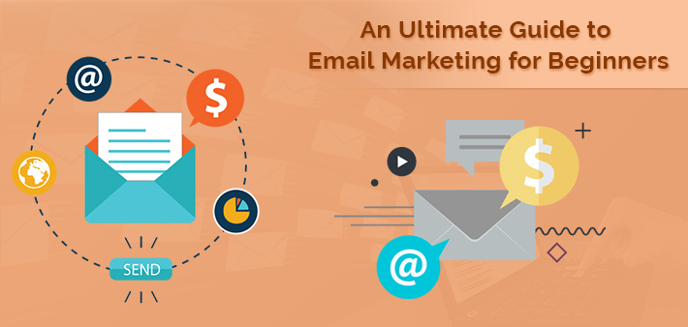
An Ultimate Guide to Email Marketing for Beginners
Notes:
Title

Slide 3
Type Of Email Marketing
Notes:
Type Of Email Marketing

Slide 4
Email Newsletters
Dedicated Emails
Lead Nurturing
Transactional Emails
Operational Emails
Notes:
Email Marketing Types

Slide 5
Effective Tips For Email Marketing
Notes:
Email Marketing Tips

Slide 6
Build your subscribe list
Don’t throw the information
Catchy and punchy subject writing
Craft punchy and engaging content
Make your email interesting
Notes:
Email Marketing Tips

Slide 7
Ensure that email are not sent to the spam
Be compliant with the CAN-SPAM Act
Avoid Spam Trigger words
In case of HTML Emails include text version
Use permission marketing techniques
Use spam checker before sending emails
Get off blacklists
Maintain a good text to image ratio
Avoid spam traps
Notes:
Email Marketing Tips

Slide 8
Make sure your copy look clean and crisp
Make the links and call to action easy and obvious
Make your email campaign mobile friendly
Test is mandatory
Track your data
Notes:
Email Marketing Tips

Slide 9
Conclusion
Email marketing is the most important tools that increase the business and this method is always evergreen. So this is no matter whichever type of email you use. Rather important that what are you trying to achieve in this campaign.
If you think that any short cut for successful email marketing, so you are wrong. It's only depend on your hard work, planning and strategy.
Notes:
Conclusion

Slide 10
Read More About This Topic
Read every points with described way in this blog
URL :- www.tis-ites.com/blog/an-ultimate-guide-to-email-marketing-for-beginners/
Notes:
Read More

Slide 11
Thanks For Watching This Presentation
--TIS Webmaster
Notes:
Thanks

